Slide 1



TREEHOOSE OSS TRE
Dr Chris Cole – Senior Lecturer in Health Informatics
19-08-2022

Slide 2







Health Informatics Centre (HIC)
Both Expert Services and an Academic Research Group
Expert Services:
To safely and efficiently enable researchers to deliver world leading research
Academic Research Group:
To deliver world-leading health informatics research
Study Feasibility Searches
Study Participant Contact & Recruitment
Governance Approval Support
Software Development
Data Linkage
Data Entry
Accredited Safe Haven

Slide 3






Electronic Medical Data Coverage
HIC Services
20%
2021
1962
Geographic Tayside and Fife
Population of Scotland
Time Period

Slide 4


/ TRE

Slide 5

The Scottish Federated Safe Haven Network
One National Safe Haven
(NSS (eDRIS)/EPCC)
4 Regional Safe Havens
A collaboration between an R&D Node of NHS Scotland and a University with a Medical School from within that region.

Slide 6

TREEHOOSE

Slide 7














Trusted Research Environments (TREs)
The 5 Safes
Safe People
Safe Projects
Safe Settings
Safe Data
Safe Outputs
Outputs
Sensitive Data
CSV
SQL
Approved User
Trusted Research Environment
On-premise Computing

Slide 8
Problem Statement
There are many TREs and all are different
Duplicated effort
Lack of shared learning
Expensive to run
TREs are not able to support researcher needs:
Large imaging datasets, Artificial Intelligence, DNA sequencing
Industrial partners are unwilling to share algorithms with TREs due to Intellectual Property issues

Slide 9








“Next Generation” TRE
Algorithms
Outputs
Sensitive Data
Enclave
CSV
SQL
Approved User
Elastic
CPU/GPU
Trusted Research Environment

Slide 10

TREEHOOSE Evolution - July 2022
HIC TRE
(Production)
New Features:
Egress app
Automated backups
Lower costs
Better data governance
On upstream path
TREEHOOSE
v1 (beta)
Missing Features:
Desktop linux
AWS TRE
(Under Development)

Slide 11
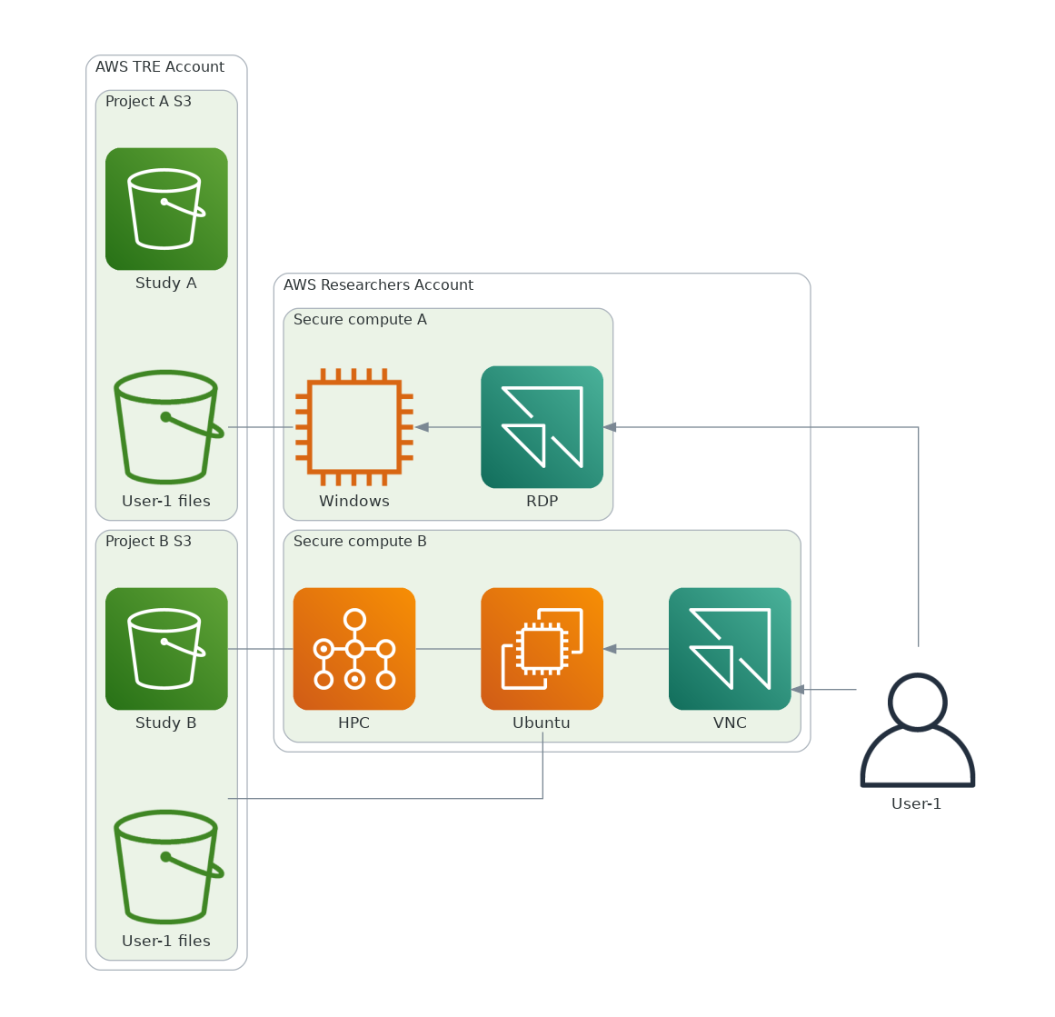
Infrastructure-as-code
Documentation to aid self-deployment
Deployment of new TRE in ~1 day
Requires experience of (AWS) cloud
AWS account management by project
Virtual display restricts copy/paste, web-browser is the only interface
No cross-over of user data between projects
Complies with Governance Requirements
Does not replace normal governance procedures

Slide 12



Personas – assumed roles
Governance
IT Admin
Deployment
Configuration
Security
Data Lake Manager
Governance
Data Access Controls
User Controls
Researcher
Data Access
Workflow dev
Data egress
Data Egress Manager
Data Checking
Data Security
Governance

Slide 13

Managing Costs
Understanding shared overheads: small number of large projects vs large number of small projects
HIC model is lots of small projects
Many projects have different compute requirements, sustained workloads tend to be short term so reserved instances won't work
Non constant interactive workloads (e.g. "office" hours) so savings plans don't work
Cloud resilience vs cost: full redundancy is expensive
TREEHOOSE infrastructure raw costs: c. $80 pm
Workspace compute + storage extra and charged per AWS std costs

Slide 14
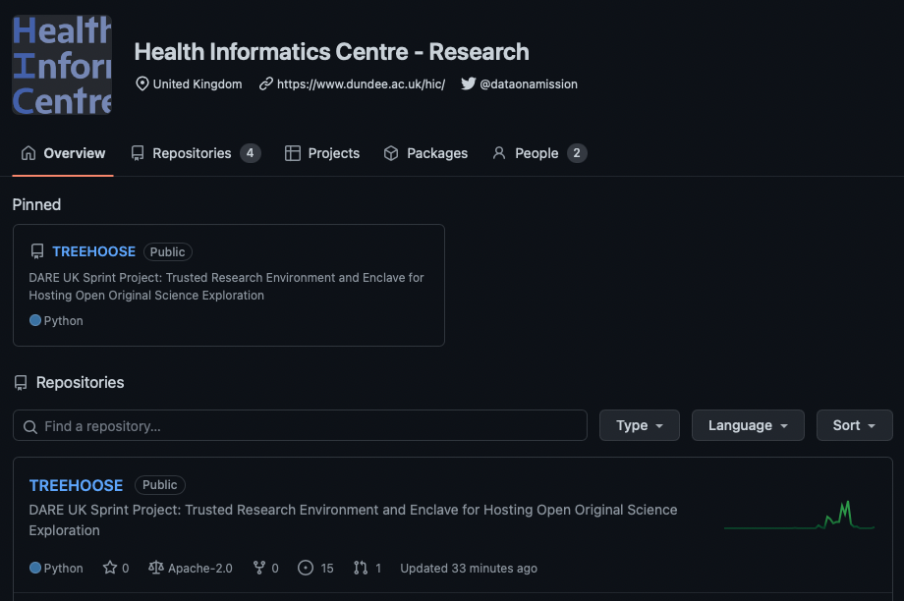
Source code and documentation available from:
github.com/HicResearch/TREEHOOSE
DOI: 10.5281/zenodo.6908253

Slide 15
Secure Enclave Computing
TREEHOOSE

Slide 16
Secure Enclave Computing

Slide 17




Third Party Org
Algorithms
Enclave
TRE
Outputs
Encryption
Management
System
CSV
Enclave
SQL
Results
Approved User

Slide 18
Thank you!
Dundee
Dr Simon Li
Dr James Sutherland
Dr Chuang Gao
Prof. Emily Jefferson
AWS Team
Brian Nelson
Phil Edwards
Maedeh Sharif Khodaei
Karan Shah
Syl Taylor
Rebecca Maeds
PPIE
Antony Chuter
Jill Beggs
PICTURES
Susan Krueger
Dr Esma Mansouri-Benssassi
TREEHOOSE

